Slide 1
AnK [Accelerated Komputing]
Transolver
Hari prasad Gajurel

Slide 2
Table of content
Visualization of slice
Visualization of loss and accuracy curve
Further work

Slide 3
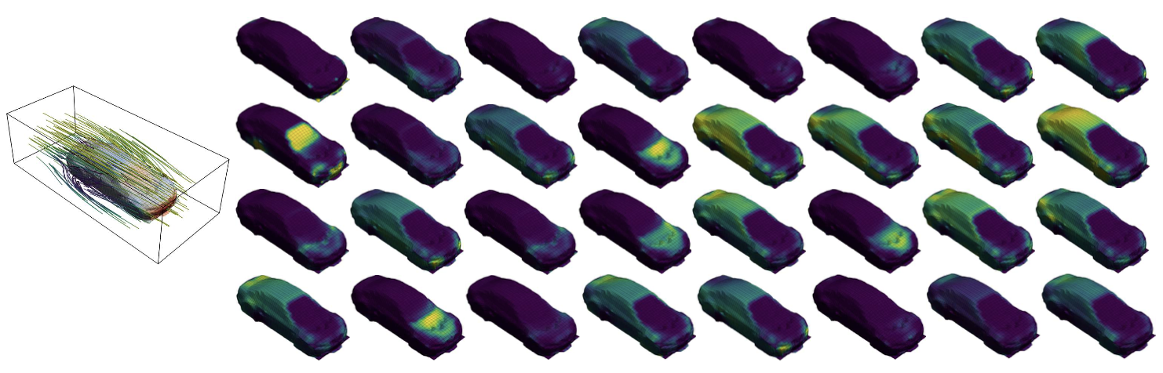
Slice visualization

Slide 4
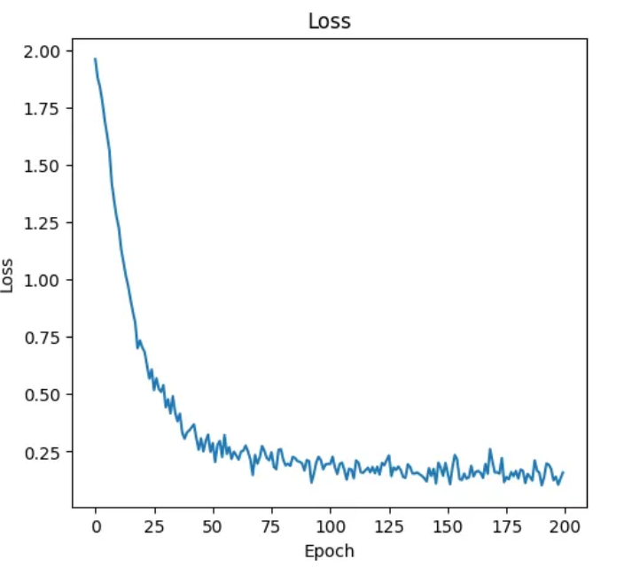
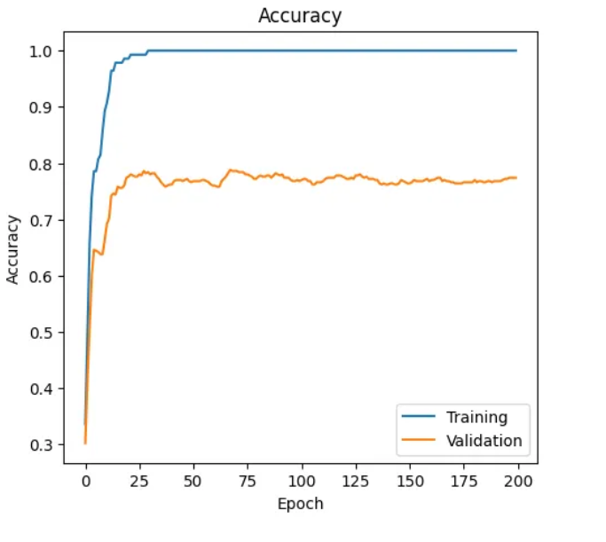
Training Performance
.

Slide 5
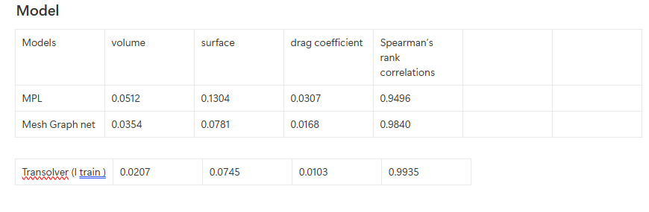
Model Evaluation

Slide 6
Further work
Apply the model in the glass forming process.
This model is in static but I will try in transient
Learn the method of expert

Slide 7



Thank you

Slide 9






Slide 11
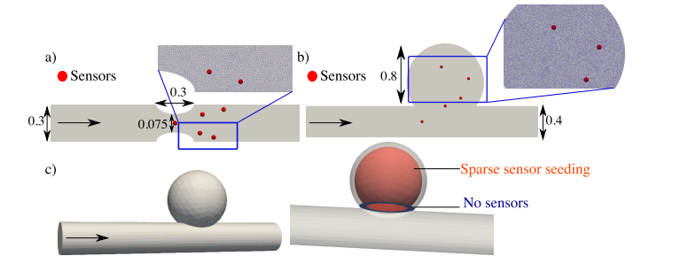
Test case 2: 2D blood flow in a stenosis

Slide 12
Test case 3: Parameter identification (viscosity)
Viscosity (µ) treated as an unknown parameter in solving the 2D stenosis problem using inverse method.
Relevant to hemorheological disorders (e.g., diabetes), assumed Newtonian flow.
Learning rate for viscosity set 10x smaller than that for velocity and pressure.

Slide 13
Reference
[1] A. Arzani, A. M. Gambaruto, G. Chen, and S. C. Shadden. Lagrangian wall shear stress structures and near-wall transport in high-Schmidt-number aneurysmal flows. Journal of Fluid Mechanics, 790:158–172, 2016.
[2] M. Mahmoudi, A. Farghadan, D. R. McConnell, A. J. Barker, J. J. Wentzel, M. J. Budoff, and A. Arzani. The story of wall shear stress in coronary artery atherosclerosis: biochemical transport and mechanotransduction. Journal of Biomechanical Engineering, 143(4), 2020.
[3] H. Samady, P. Eshtehardi, M. C. McDaniel, J. Suo, S. S. Dhawan, C. Maynard, L. H. Timmins, A. A. Quyyumi, and D. P. Giddens. Coronary artery wall shear stress is associated with progression and transformation of atherosclerotic plaque and arterial remodeling in patients with coronary artery disease. Circulation, 124(7):779–788, 2011.

Slide 14


Test case 1: 1D advection-diffusion transport
Consider the steady advection –diffusion equation:
For the given boundary condition we can obtain this analytical solution.

